Slide 2




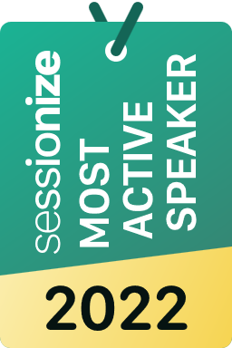



Who am I
marco_parenzan
marcoparenzan
marcoparenzan
marcoparenzan
MARCO PARENZAN

Slide 4
C# 12
Speaker name

Slide 5
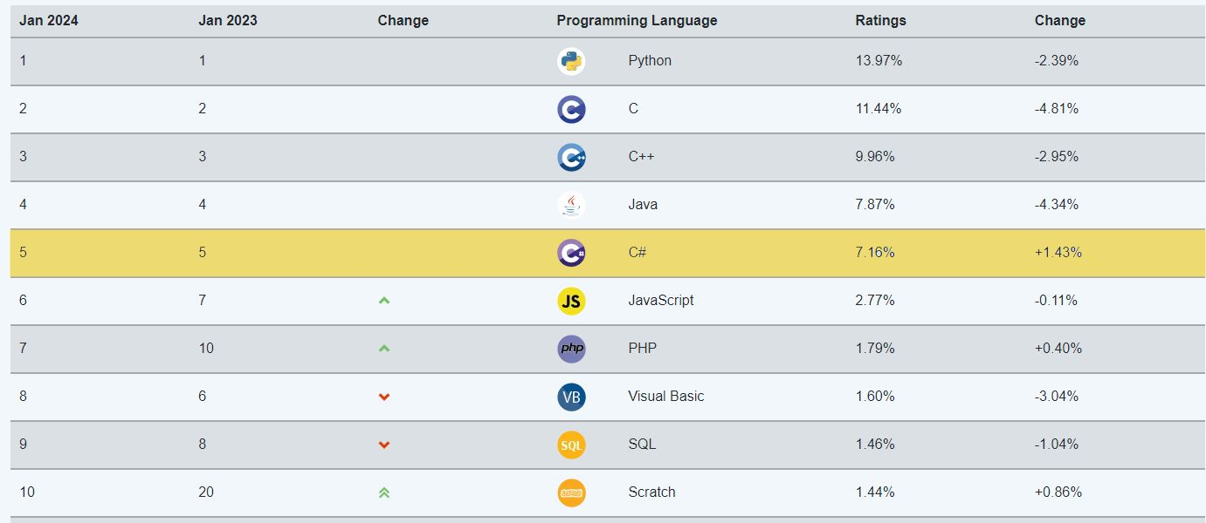
TIOBE INDEX 2023!
https://www.tiobe.com/tiobe-index/

Slide 6
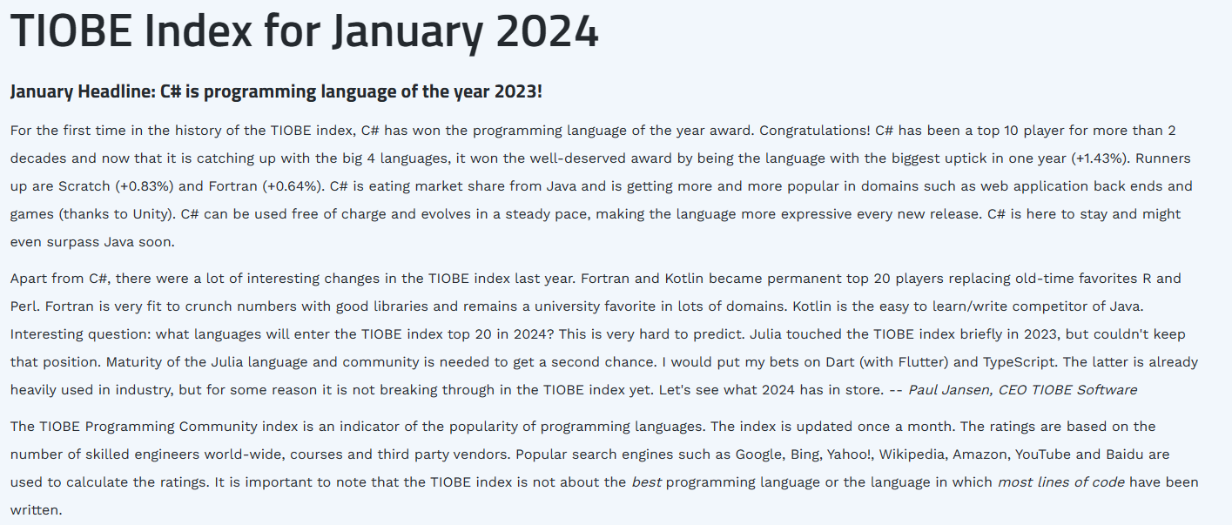
TIOBE INDEX 2023!
https://www.tiobe.com/tiobe-index/

Slide 7
C#12
Primary Constructors
Global parameters of the class (capture)
THE MAIN Constructor!
Collection Initializers
Default implementation inference with collection interfaces
Pattern matching
Ilist/IEnumerable
Alias Global
Spread Operators
Pattern matching with collection intializers
Primary constructors
Collection expressions
Inline arrays
Optional parameters in lambda expressions
Ref readonly parameters
Alias any type
Experimental attribute
Interceptors
Notes:
Inline arrays - Introduced in Visual Studio 2022 version 17.7 Preview 3.
Optional parameters in lambda expressions - Introduced in Visual Studio 2022 version 17.5 Preview 2.
Interceptors - Preview feature Introduced in Visual Studio 2022 version 17.7 Preview 3.

Slide 8
https://learn.microsoft.com/en-us/dotnet/csharp/whats-new/csharp-version-history

Slide 9
Codice manutenibile può essere ottimizzato Codice ottimizzato non è detto che possa essere manutenibile

Slide 10
Pythonismo

Slide 11
Produttività

Slide 12
Declarative approach

Slide 13
Syntactic Sugar

Slide 14
Everyday C# and natural biases
Everyday C# doesn’t mean “edit all your code now.”
Everyday C# doesn’t mean “use only the new features”
Everyday C# doesn’t mean “use only time-tested idioms.”
Older features aren’t necessarily easier.
Experience C# developers learned them first because we’ve been on this journey longer.
Newer features aren’t necessarily advanced.
They are just new to everyone.
There are fewer resources to learn them.

Slide 15
C#12
Primary Constructors
Global parameters of the class (capture)
THE MAIN Constructor!
Collection Initializers
Default implementation inference with collection interfaces
Pattern matching
Ilist/IEnumerable
Alias Global
Spread Operators
Pattern matching with collection intializers
Primary constructors
Collection expressions
Inline arrays
Optional parameters in lambda expressions
Ref readonly parameters
Alias any type
Experimental attribute
Interceptors
Notes:
Inline arrays - Introduced in Visual Studio 2022 version 17.7 Preview 3.
Optional parameters in lambda expressions - Introduced in Visual Studio 2022 version 17.5 Preview 2.
Interceptors - Preview feature Introduced in Visual Studio 2022 version 17.7 Preview 3.

Slide 16
Road to C#12

Slide 17
C# 9.0
Records
Init only setters
Top-level statements
Pattern matching enhancements
Target-typed new expressions
Native sized integers
Function pointers
Suppress emitting localsinit flag
static anonymous functions
Target-typed conditional expressions
Covariant return types
Extension GetEnumerator support for foreach loops
Lambda discard parameters
Attributes on local functions
Module initializers
New features for partial methods
https://github.com/dotnet/roslyn/blob/master/docs/Language%20Feature%20Status.md

Slide 18
C# 10.0
Record structs
Improvements of structure types
global using directives
File-scoped namespace declaration
Extended property patterns
Improvements on lambda expressions
Allow const interpolated strings
Allow both assignment and declaration in the same deconstruction
https://github.com/dotnet/roslyn/blob/master/docs/Language%20Feature%20Status.md

Slide 19
C# 11.0
More patterns List pattern Slice pattern Span pattern
nameof(parameter)
Cache delegates for static method group
Required properties
required string Name { get; init; }
Raw string literals
Static members in interfaces
UTF-8 string Literals
ReadOnlySpan<byte> span = "Filip Ekberg"u8;
Generic math support
Generic attributes
[ThisisAGenericAttribute<string>()]
Parameter null-checking (!!) was been withdrawn due to community feedback
Notes:
5-10 min

Slide 20
Pattern Matching

Slide 21
Matching a type & ”attribute”
if(fruit.GetType() == typeof(Apple) && fruit.Color == Color.Green)
{
var apple = fruit as Apple;
var food = MakeApplePieFrom(apple);
}
C# 1.0 – 6.0
switch(fruit)
{
case Apple apple when apple.Color == Color.Green:
var food = MakeApplePieFrom(apple);
break;
default:
break;
}
C# 7.0

Slide 22
Pattern matching: Switch expression
var result = input switch
{
};
The object you want to create patterns for
@fekberg

Slide 23
Patterns in C#
Type pattern
Positional pattern
Property pattern
Tuple pattern
Relational pattern
Conjunctive “and” pattern
Disjunctive “or” pattern
List pattern
Parenthesized pattern
Negated “not” pattern
Recursive patterns

Slide 24

Resources
Download .NET 8 aka.ms/get-dotnet-8
What’s new in C# https://learn.microsoft.com/dotnet/csharp/whats-new/csharp-12
Everyday C# GitHub project https://github.com/orgs/dotnet/projects/225
Pattern matching tutorial https://learn.microsoft.com/dotnet/csharp/fundamentals/tutorials/pattern-matching

Slide 25
https://learn.microsoft.com/en-us/dotnet/csharp/whats-new/csharp-12
https://github.com/dotnet/roslyn
https://github.com/dotnet/csharplang

Slide 26
Download .NET 8
https://aka.ms/get-dotnet-8

